Slide 1


Project 2: Javascript Game
September 8, 2021

Slide 2
GAME CONCEPT
Player will follow the list of ingredients to bake a pizza specified by customer.
Player will serve as many customers as s/he within 30 seconds.

Slide 3
TARGET
Kids
(plus kids at heart)
So this better be cute.

Slide 4


















IMAGES
Maria’s Random Customers
The Ingredients
From Canva
From Vecteezy

Slide 5
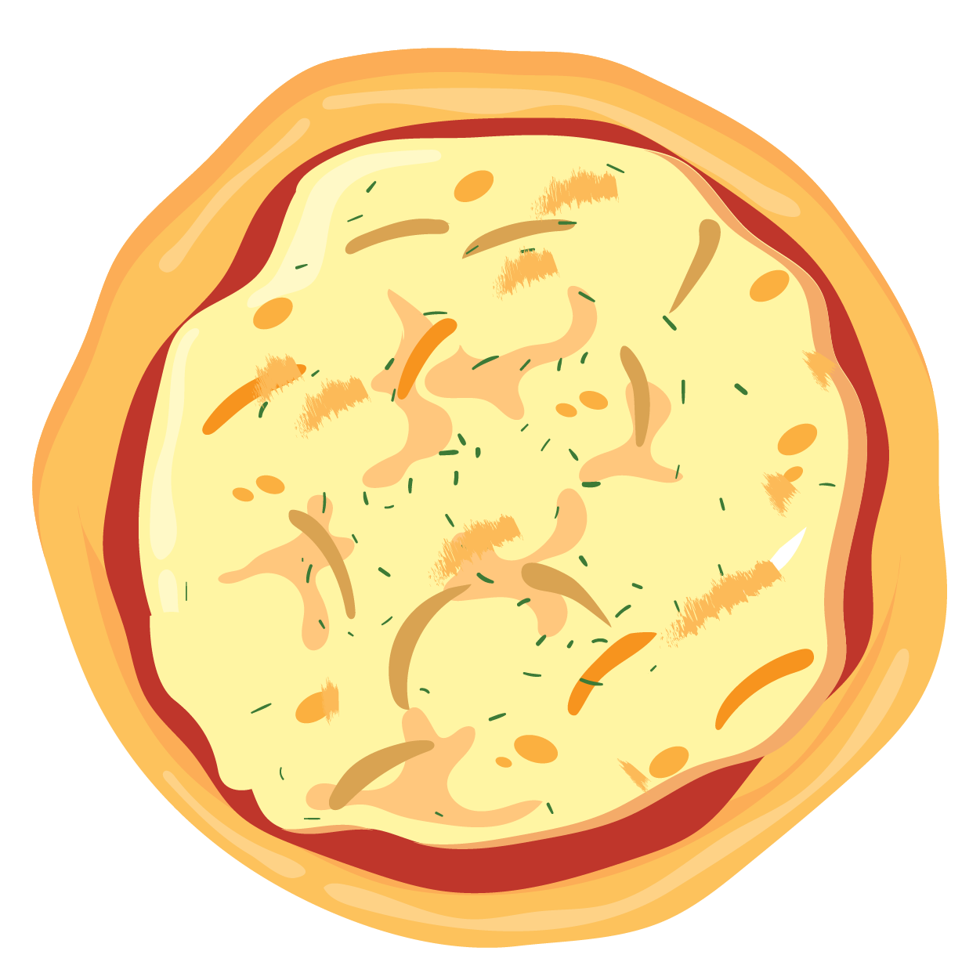
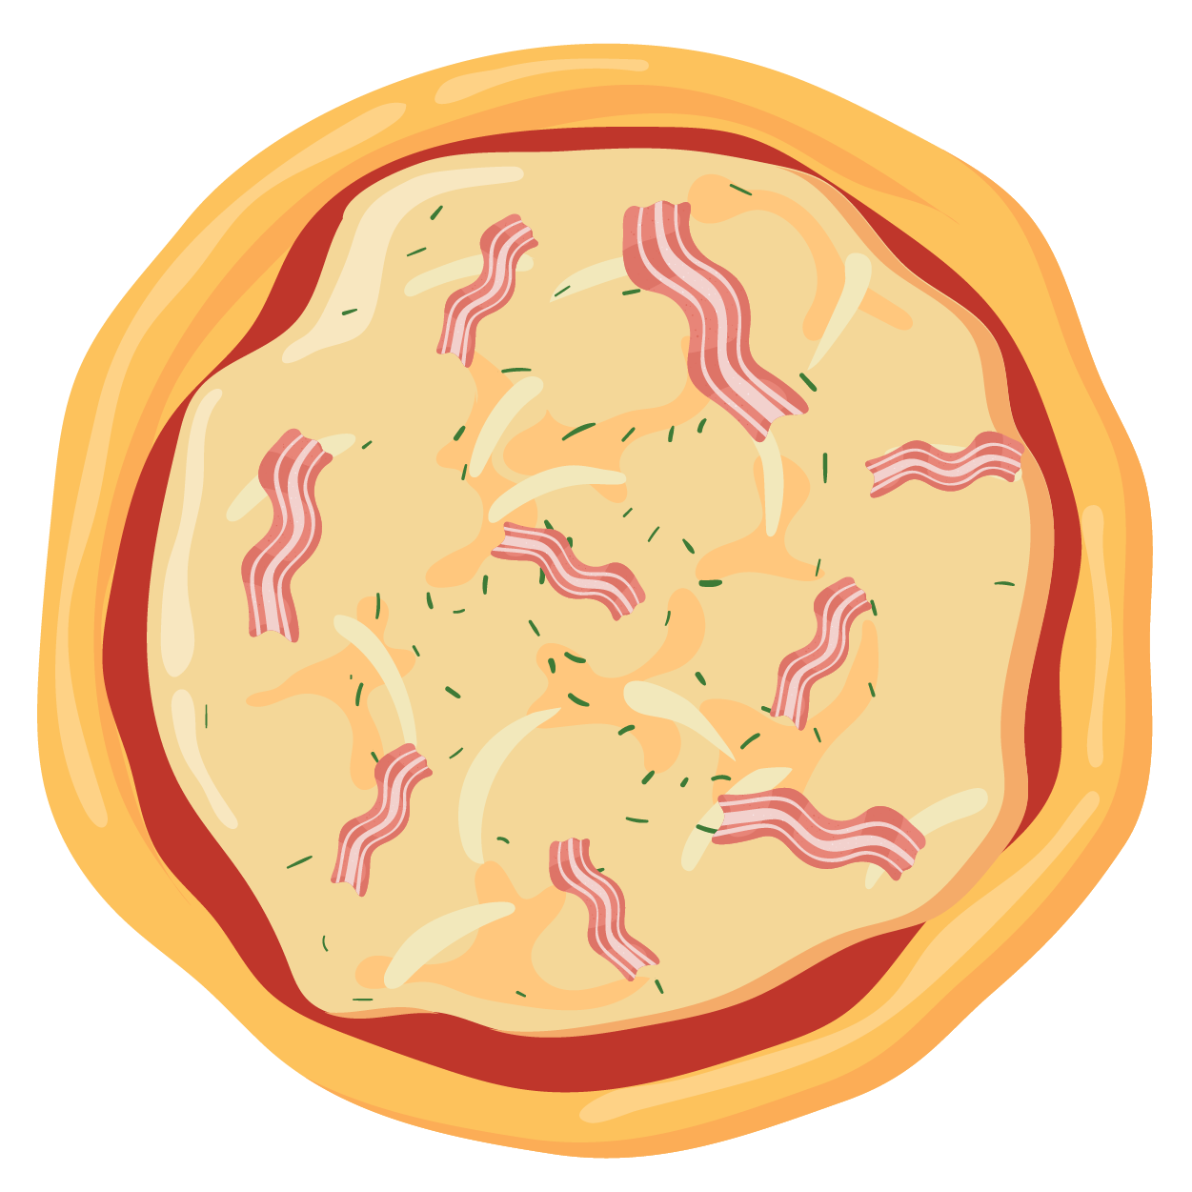
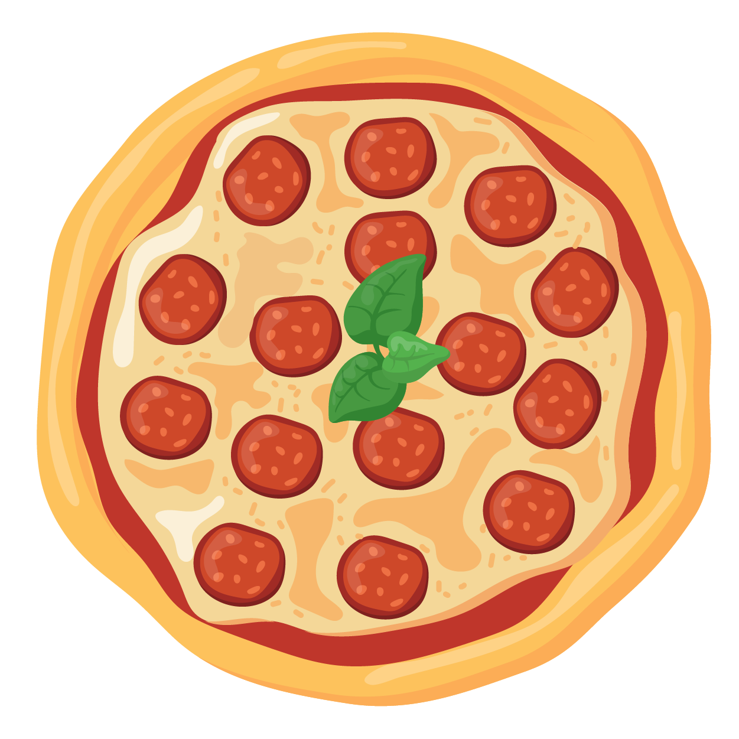
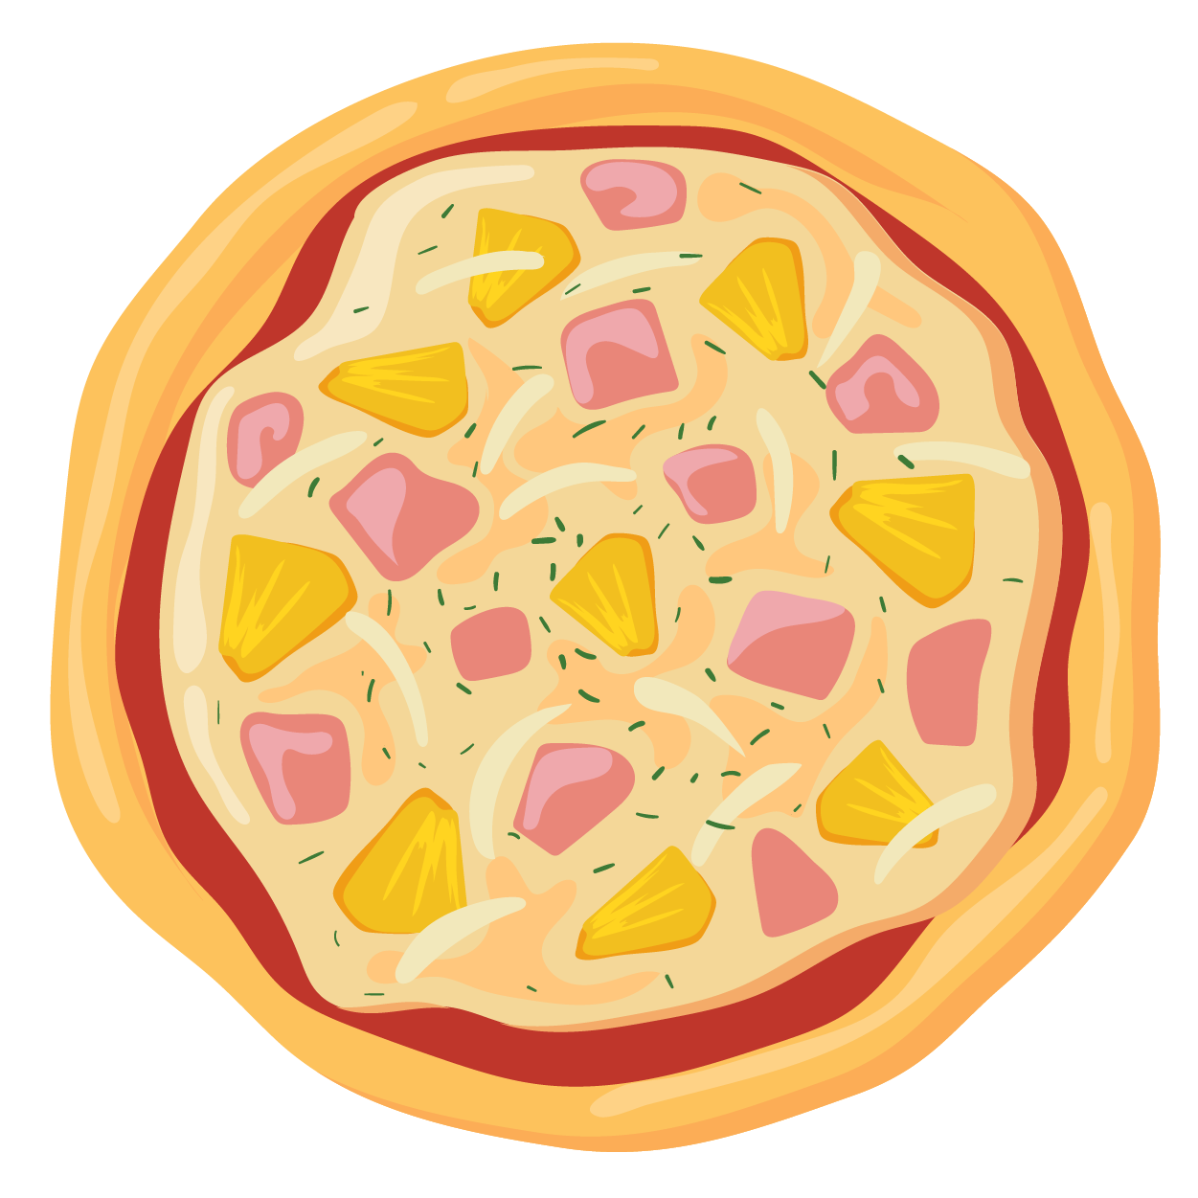
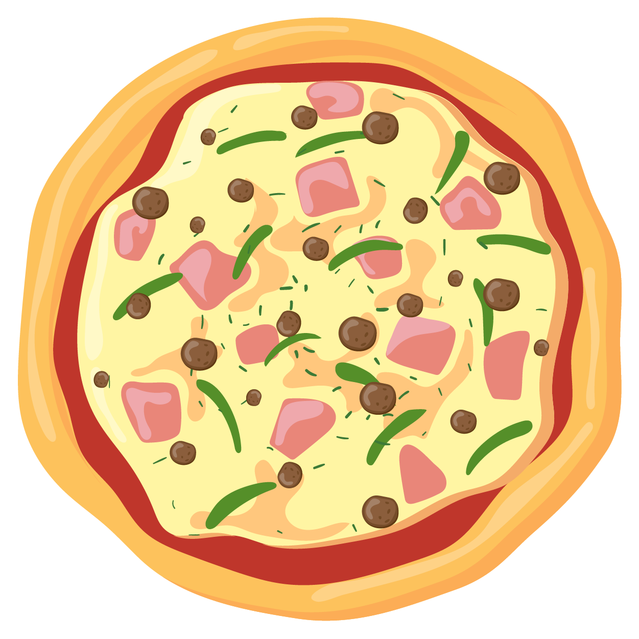
IMAGES
The Pizzas
CHEESE PIZZA
Php 500
BACON PIZZA
Php 700
PEPPERONI PIZZA
Php 600
HAWAIIAN PIZZA
Php 700
SUPREME PIZZA
Php 800
From Freepik and Jerome Tan

Slide 6
FONT STYLE
POPPINS
Quicksand

Slide 7
COLORS
252 248 200 | 255 211 123 | 255 192 55 | 253 182 30 | 216 255 204 | 177 231 161 | 61 211 118 | 11 161 118 | 7 110 47 | 255 97 109 | 216 58 86 | 207 207 207 | 78 78 78

Slide 8
LAYOUT

Slide 9
Game Name
Customer img
Pizza Image
Timer
Total Sales
Customers Served
Customer order
Serve this pizza!
Recipe Book
Ingredients
Prep Table
Discard
Bake

Slide 10
gameDiv
infoDiv
statsDiv
customerDiv
gameNameDiv
customerImgDiv
bakedPizzaImgDiv
bakedPizzaDiv
timerDiv
salesDiv
customers
servedDiv
customerOrderDiv
servePizzaBtn
recipeBookDiv
recipeDiv
ingredientsDiv
prepTableDiv
chefTableDiv
prepTableMainDiv
prepTableBtnsDiv
clearBtn
bakeBtn

Slide 11
